Slide 1
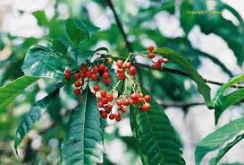
Solution to HW09

Slide 2
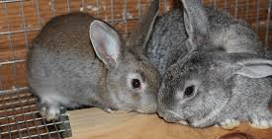
Mounting Frequency (MF) results for rabbits
0 mg/kg MECLR 2, 3, 3, 3, 3
40 mg/kg MECLR 4, 5, 5, 5, 6
80 mg/kg MECLR 6, 6, 7, 8, 8
0.5 mg/kg sildenafil 8, 9, 11, 11, 11

Slide 3
Mounting Frequency (MF) results for rabbits
0 mg/kg MECLR 2, 3, 3, 3, 3
40 mg/kg MECLR 4, 5, 5, 5, 6
80 mg/kg MECLR 6, 6, 7, 8, 8
0.5 mg/kg sildenafil 8, 9, 11, 11, 11
Q1: regression line for predicting MF from dosage of MECLR?

Slide 4
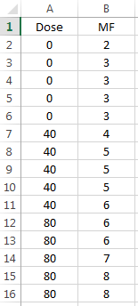
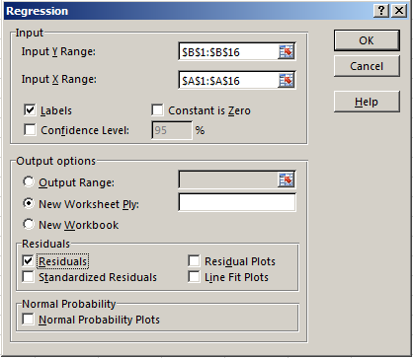

Slide 5
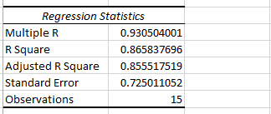

Q1: regression line
pred MF = 2.833 + 0.0525(dose)

Slide 6
Q2: avg prediction error
SE_{Y|X} = 0.725

Slide 7
Q3: is relation stat. significant?
T = 0.0525 / 0.00573 = 9.16

Slide 8
Q3: is relation stat. significant?
T = r / sqrt(1–r²) *sqrt(13)
= 9.16

Slide 9
Q4: 95% conf. interval for β₀?
(Note: if linear, better to estimate Y at X=0 using b₀, not just data at X=0)

Slide 10
Q4: 95% conf. interval for β₀?
95% conf. w/ 13df → T = 2.16, 95% CI for β₀ is 2.19 to 3.47

Slide 11
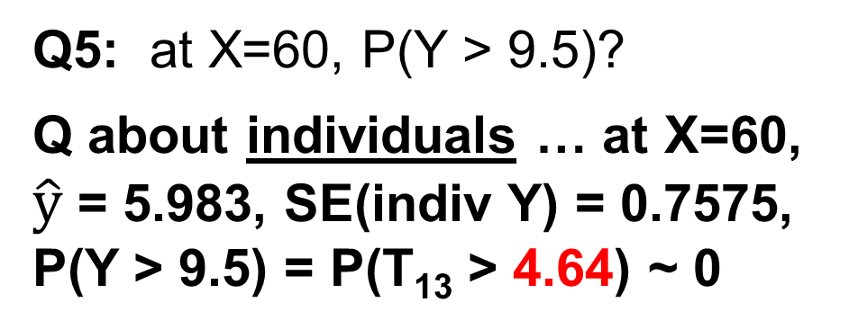
Q5: at X=60, P(Y > 9.5)?
Q about individuals … at X=60, $\hat{y}$ = 5.983, SE(indiv Y) = 0.7575, P(Y > 9.5) = P(T₁₃ > 4.64) ~ 0

Slide 12
Mounting Frequency (MF) results for rabbits
0 mg/kg MECLR 2, 3, 3, 3, 3
40 mg/kg MECLR 4, 5, 5, 5, 6
80 mg/kg MECLR 6, 6, 7, 8, 8
0.5 mg/kg sildenafil 8, 9, 11, 11, 11
Q6: Assuming MECLR and sildenafil citrate are identical, what is the p-value for the slope of the regression line predicting MF from amount of aphrodisiac?
b₁ = 0.0041, SE(b₁) = 0.01984, T = 0.206, p = 0.419
r = 0.0486, T = r / sqrt(1 – r²) * sqrt(18) = 0.206

Slide 13
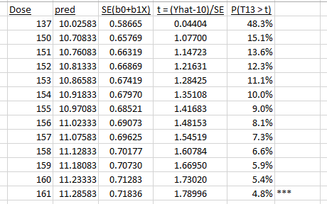
Q7: what dosage of MECLR is required to be 95% confident that the average MF at that dosage exceeds 10.0?

Slide 14
Q8: If one does not assume linearity, is there a statistically relationship between amount of MECLR and mounting frequency?
Use ANOVA, k = 3 groups (0, 40, 80)
Sum Sq df Mean Sq F
Between 44.133 2 22.067 38.94
Within 6.800 12 0.567
Total 50.933 14

Slide 15
Q9: most reasonable conclusion?
Slope is statistically significant
This was a randomized experiment, so we can conclude causality
MECLR may not bet the same as sildenafil citrate, so we should not group MECLR and sildenafil
Based on the data from 0, 40, and 80 mg/kg of MECLR, we conclude that MECLR caused an increase in mounting frequency for rabbits, since the slope is statistically significantly positive.

Slide 16
Q10: if a researcher concludes that MECLR has an effect on mating behavior of rabbits, and it is later proven that MECLR has no effect on rabbits, what error did the researcher make?
This is an error of paranoia (over-excitement): in truth, there is no effect, but the researcher claims there is an effect: Type I error

Slide 17
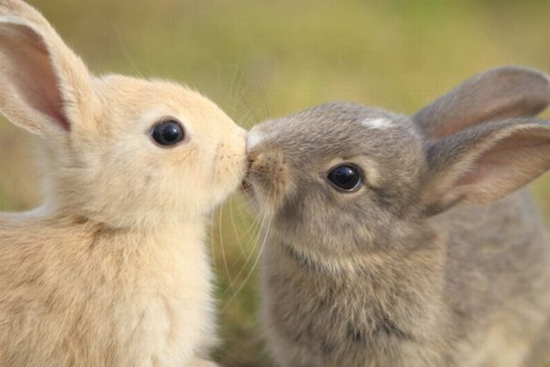
Question on HW09?

